Slide 1

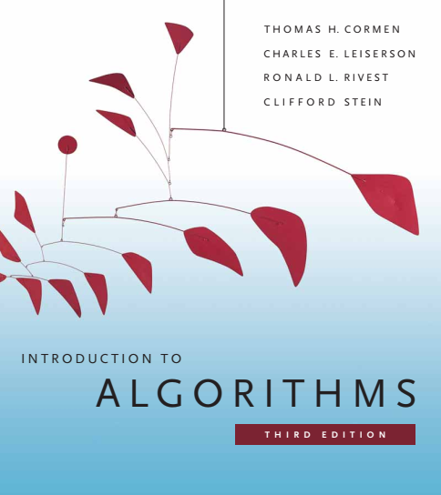
Design and Analysis of Algorithms
Dr. Sajid Iqbal
Reference Book
Introduction to Algorithms 3rd Edition By Thomas H. Cormen et. al.
https://mitpress.mit.edu/books/introduction-algorithms-third-edition
COMEDXD

Slide 2
Growth of Function
Chapter 3

Slide 3
Background
Order of growth of the running time of an algorithm shows a picture (measure) of algorithm efficiency
Using this picture (measure), we can approximately compare algorithms
Asymptotic Efficiency: The measure of approximate efficiency
We are concerned with how the running time of an algorithm increases with the increase in the size of the input
The Asymptotic efficiency is valid for large enough input size

Slide 4
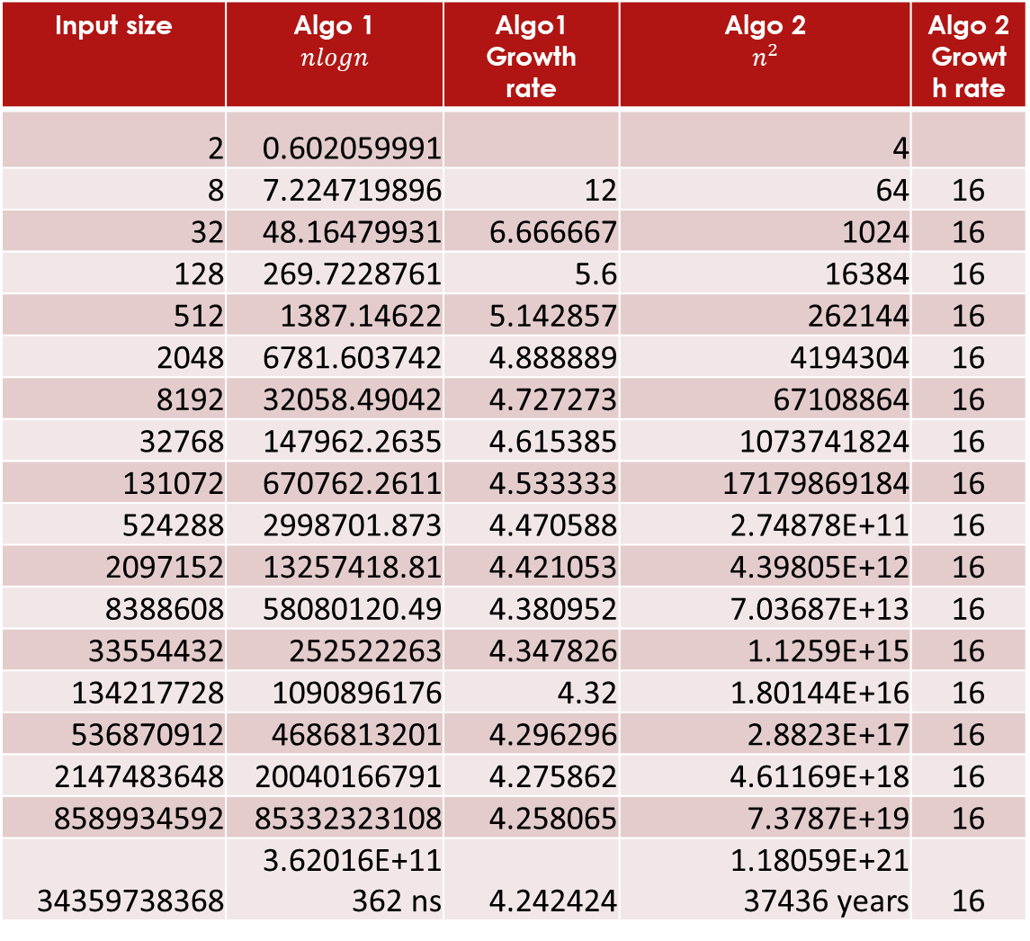
The growth rate
Input size | Algo 1 $$nlogn$$ | Algo1 Growth rate | Algo 2 $$n^{2}$$ | Algo 2 Growth rate
2 | 0.602059991 |  | 4
8 | 7.224719896 | 12 | 64 | 16
32 | 48.16479931 | 6.666667 | 1024 | 16
128 | 269.7228761 | 5.6 | 16384 | 16
512 | 1387.14622 | 5.142857 | 262144 | 16
2048 | 6781.603742 | 4.888889 | 4194304 | 16
8192 | 32058.49042 | 4.727273 | 67108864 | 16
32768 | 147962.2635 | 4.615385 | 1073741824 | 16
131072 | 670762.2611 | 4.533333 | 17179869184 | 16
524288 | 2998701.873 | 4.470588 | 2.74878E+11 | 16
2097152 | 13257418.81 | 4.421053 | 4.39805E+12 | 16
8388608 | 58080120.49 | 4.380952 | 7.03687E+13 | 16
33554432 | 252522263 | 4.347826 | 1.1259E+15 | 16
134217728 | 1090896176 | 4.32 | 1.80144E+16 | 16
536870912 | 4686813201 | 4.296296 | 2.8823E+17 | 16
2147483648 | 20040166791 | 4.275862 | 4.61169E+18 | 16
8589934592 | 85332323108 | 4.258065 | 7.3787E+19 | 16
34359738368 | 3.62016E+11 362 ns | 4.242424 | 1.18059E+21 37436 years | 16

Slide 5

Asymptotic notation
The running time of an algorithm is represented using natural numbers
Let if $n$ is the size of input then $f(n)$ is the function describing the running time of the algorithm
For example this running time could be of the form
$f\left(n\right)=an^{2}+bn+c=\sum_{0}^{2}{a_{i}n^{i}}$
A function can perform differently for different combination of same input
It may perform best – best case
It may perform average – average case
It may perform worst – worst case

Slide 6
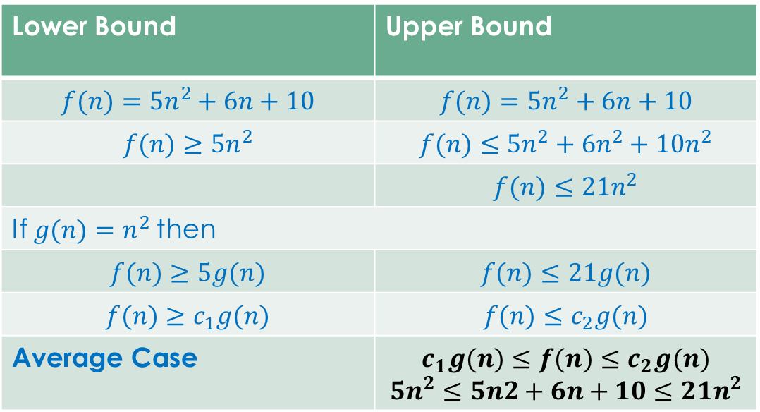

Upper and lower bounds of a function
Let suppose the time complexity of our function is $f(n)=5n2+6n+10$
[6, 5, 4, 3, 2, 1]
[2, 4, 5, 6, 1, 3]
[2, 4, 5, 6, 1, 3]
[1, 2, 4, 5, 6, 3]
[1, 2, 3, 4, 5, 6]
Lower Bound | Upper Bound
$$f(n)=5n^{2}+6n+10$$ | $$f(n)=5n^{2}+6n+10$$
$$f(n)≥5n^{2}$$ | $$f(n)≤5n^{2}+6n^{2}+10n^{2}$$
 | $$f(n)≤21n^{2}$$
If $g(n)=n^{2}$then
$$f(n)≥5g(n)$$ | $$f(n)≤21g(n)$$
$$f(n)≥c_{1}g(n)$$ | $$f(n)≤c_{2}g(n)$$
Average Case | $$c_{1}g(n)≤f(n)≤c_{2}g(n)$$ $$5n^{2}≤5n2+6n+10≤21n^{2}$$
def insertionSort(arr): for j in range(1, len(arr)): key = arr[j] i = j - 1 while i >= 0 and arr[i]<key: arr[i + 1] = arr[i] i = i - 1 arr[i + 1] = key arr = [2,5,4,6,1,3] insertionSort(arr) print("Sorted array is:") for i in range(len(arr)): print("%d" % arr[i])

Slide 7
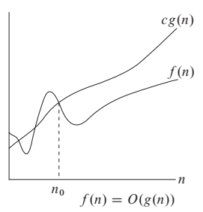

Big O-notation
$O(g(n))$={$f(n):$there exists positive constant c and n0 such that
$0≤f\left(n\right)≤cg\left(n\right) ∀ n≥n_{0}$}
$f(n)$and $g(n)$are two different functions
C is some constant when multiplied with g(n) gives upper bound
$n_{0}$is the input size after which the relationship $f\left(n\right)≤cg\left(n\right)$ remains true
Example: $f(n)=O(g(n))$when $f\left(n\right)≤c_{1}n^{2}$

Slide 8
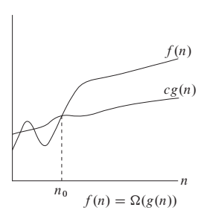


Big Omega Notation ($Ω$)
$Ω(g(n))$={$f(n):$there exists positive constant c and $n_{0}$ such that
$cg\left(n\right)≤f\left(n\right) ∀ n≥n_{0}$}
$f(n)$and $g(n)$are two different functions
C is some constant when multiplied with g(n) gives lower bound
$n_{0}$is the input size after which the relationship $f\left(n\right)≤cg\left(n\right)$ remains true
Example: $f(n)=Ω(g(n))$ when${ c}_{1}n^{2}≤f\left(n\right)$

Slide 9
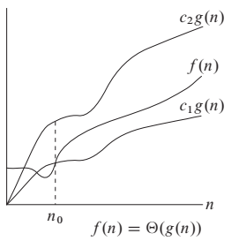


$θ$-Notation ($θ$)
$θ(g(n))$={$f(n):$there exists positive constant c and $n_{0}$ such that
$c_{1}g\left(n\right)≤f\left(n\right){≤c}_{2}g\left(n\right) ∀ n≥n_{0}$}
$f(n)$and $g(n)$are two different functions
C is some constant when multiplied with g(n) gives lower bound
$n_{0}$is the input size after which the relationship $c_{1}g\left(n\right)≤f\left(n\right){≤c}_{2}g\left(n\right)$remains true
Example: $f(n)=θ(g(n))$ when${ c}_{1}n^{2}≤f\left(n\right)$ ${≤c}_{2}n^{2}$

Slide 10
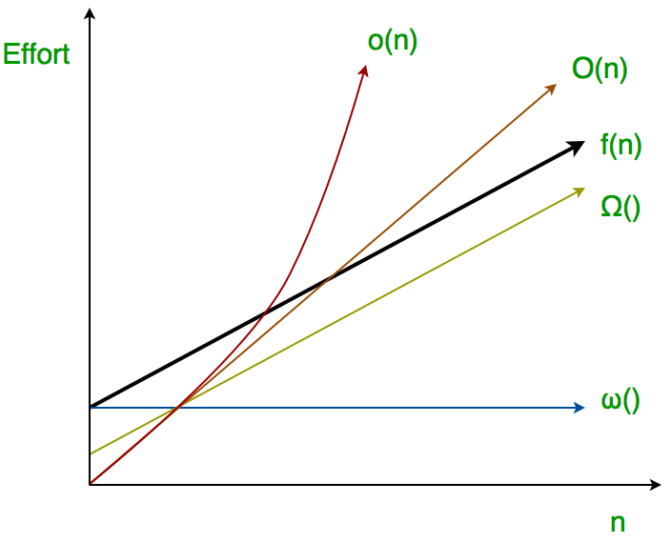

Other Asymptotic notations
We may use asymptotic notations in equations like
$2n^{2}+3n+1$as $2n^{2}+θ(n)$ where $f\left(n\right)=θ\left(n\right)=3n+1$
Asymptotically tight bounds are
$Ω, θ, Ο$
Asymptotically loose bounds are
Small o (o)-notation
$o(g(n))$={$f(n):$there exists positive constant c and n0 such that
$0<f\left(n\right)<cg\left(n\right) ∀ n≥n_{0}$}
$ω$-notation
$ω(g(n))$={$f(n):$there exists positive constant c and n0 such that
$cg\left(n\right)<f\left(n\right) ∀ n≥n_{0}$}

Slide 11

Comparing functions
Many of the real number properties hold for asymptotic comparisons
Transitivity
$f\left(n\right)=θg\left(n\right) and g\left(n\right)=θh\left(n\right) then f\left(n\right)=θh(n)$
$f\left(n\right)=Ωg\left(n\right) and g\left(n\right)=Ωh\left(n\right) then f\left(n\right)=Ωh(n)$
$f\left(n\right)=Οg\left(n\right) and g\left(n\right)=Οh\left(n\right) then f\left(n\right)=Οh(n)$
$f\left(n\right)=og\left(n\right) and g\left(n\right)=oh\left(n\right) then f\left(n\right)=oh(n)$
$f\left(n\right)=ωg\left(n\right) and g\left(n\right)=ωh\left(n\right) then f\left(n\right)=ωh(n)$
Reflexivity
$f\left(n\right)= θf\left(n\right) , f\left(n\right)= Ωf\left(n\right),f\left(n\right)= Οf\left(n\right)$

Slide 12

Standard notations and common functions
Monotonicity
Monotonically increase: if $m≤n then f\left(m\right)≤f\left(n\right)$
Monotonically decreasing: if $m≤n then f\left(m\right)≥f\left(n\right)$
Strictly increasing: if $m<n then f\left(m\right)<f\left(n\right)$
Strictly decreasing: if $m<n then f\left(m\right)>f\left(n\right)$
Floors and ceilings
Modular arithmetic
Polynomials: Polynomial of degree n can be represented as $\sum_{1}^{n}{a_{i}n^{i}}$
Exponentials

Slide 13

Common functions
Logarithm:
$a^{n}=b −→ \log_{a}{b=n}$
$Log n =\log_{2}{n}$
$ln e=\log_{e}{n} where e= 2.71828$
$\log^{k}{n}={\left(\log{n}\right)}^{k}$

Slide 14
Thanks for watching
Dr. Sajid Iqbal
Assistant Professor
Department of Computer Science
Bahauddin Zakariya University, Multan
Allah Hafiz

Slide 15
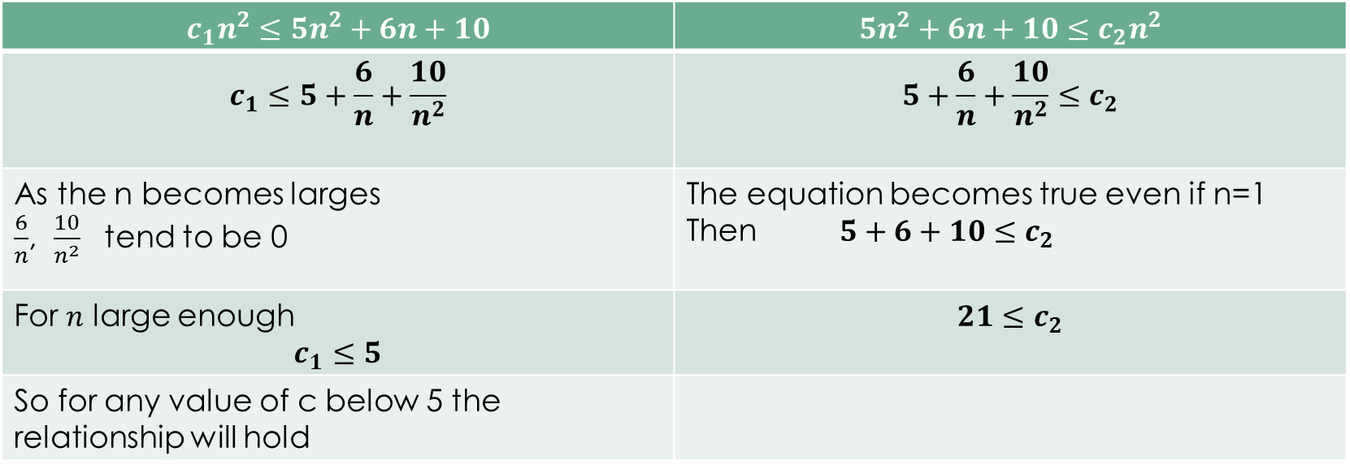

Finding constants
From previous example, we know that
$5n^{2}≤5n^{2}+6n+10≤21n^{2}$
$c_{1}n^{2}≤5n^{2}+6n+10≤c_{2}n^{2}$
$$c_{1}n^{2}≤5n^{2}+6n+10$$ | $$5n^{2}+6n+10≤c_{2}n^{2}$$
$$c_{1}≤5+\frac{6}{n}+\frac{10}{n^{2}}$$ | $$5+\frac{6}{n}+\frac{10}{n^{2}}≤c_{2}$$
As the n becomes larges $\frac{6}{n}$, $\frac{10}{n^{2}}$ tend to be 0 | The equation becomes true even if n=1 Then $5+6+10≤c_{2}$
For $n$ large enough $$c_{1}≤5$$ | $$21≤c_{2}$$
So for any value of c below 5 the relationship will hold

